Slide 1
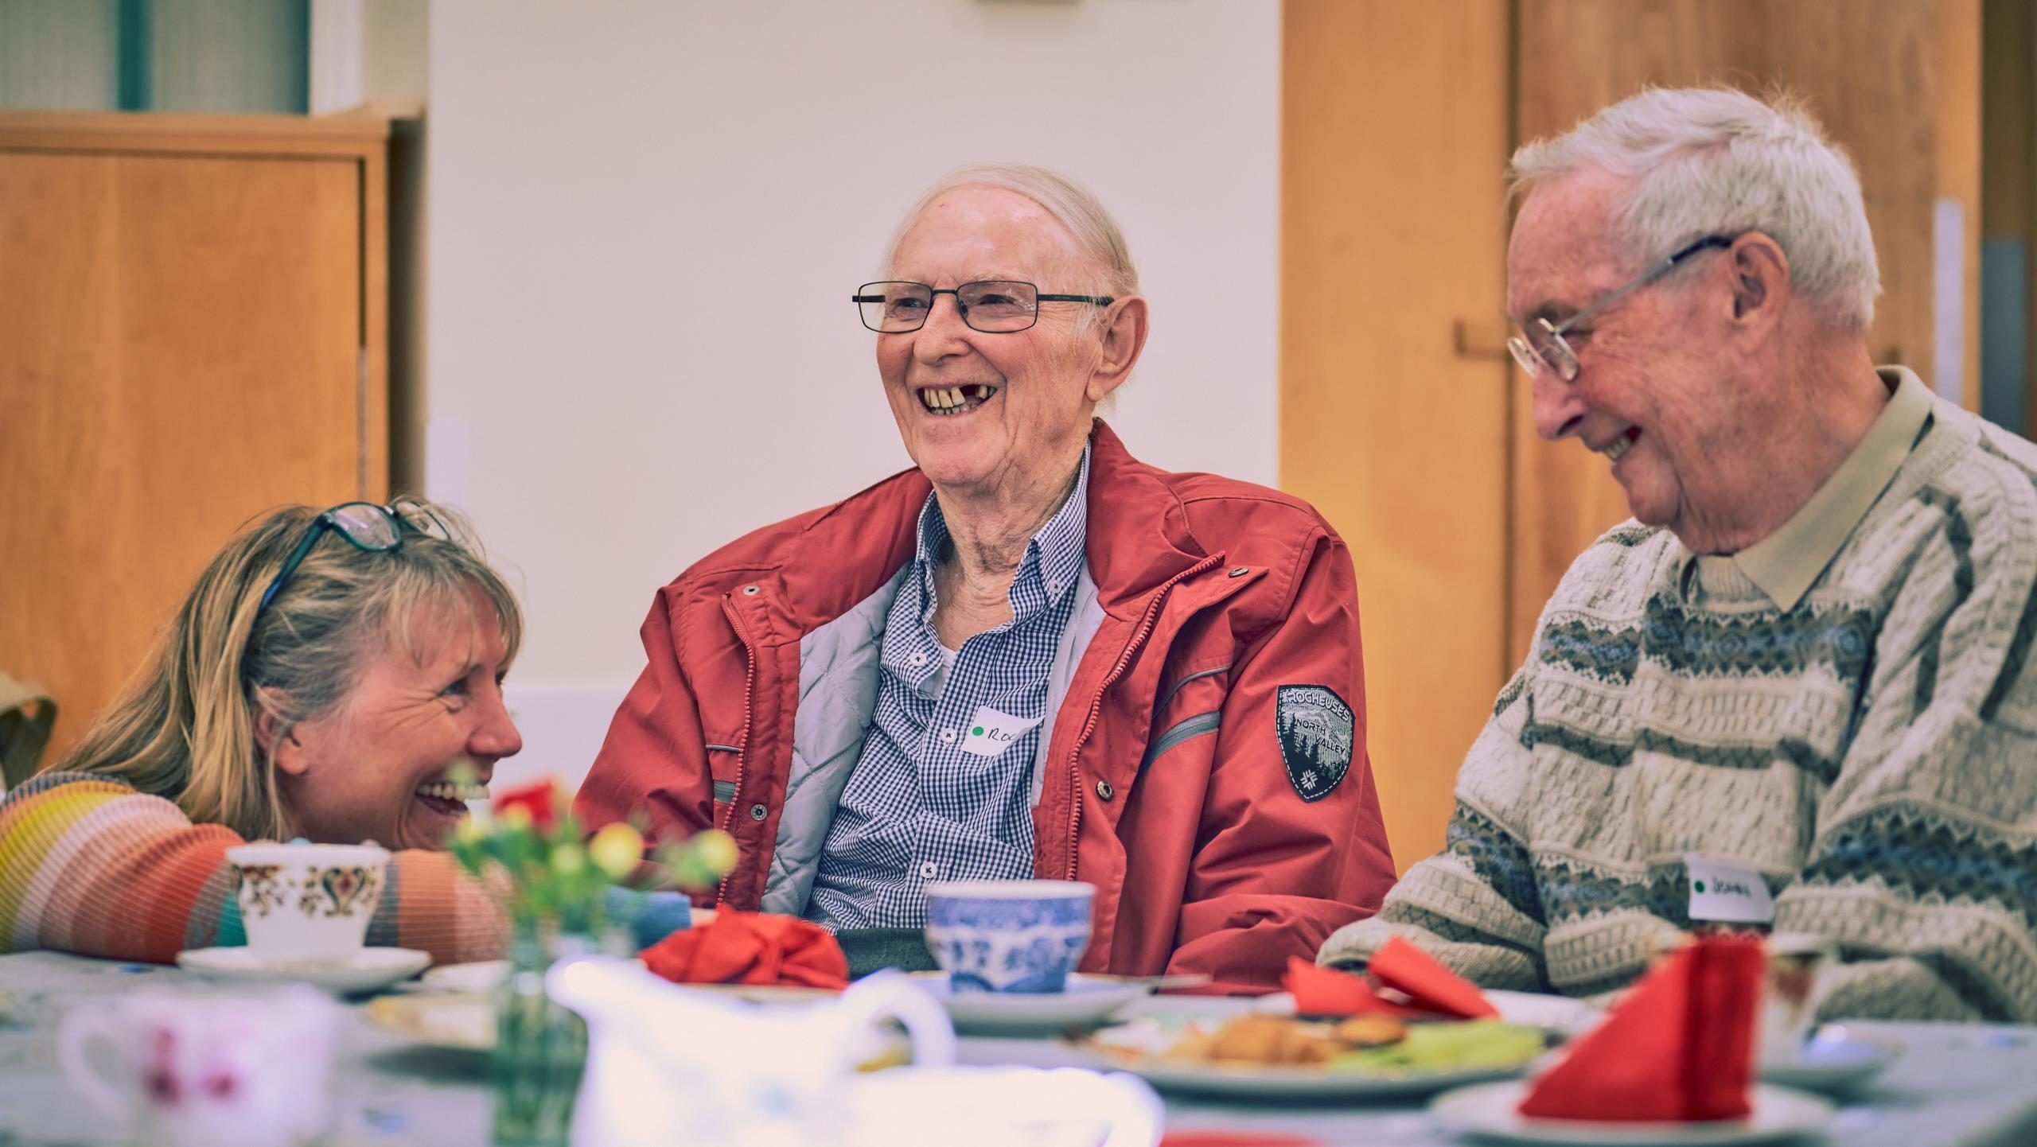
MCCARTHY STONE FOUNDATION
Grant Funding in 2024
Pre-application Webinar

Slide 2
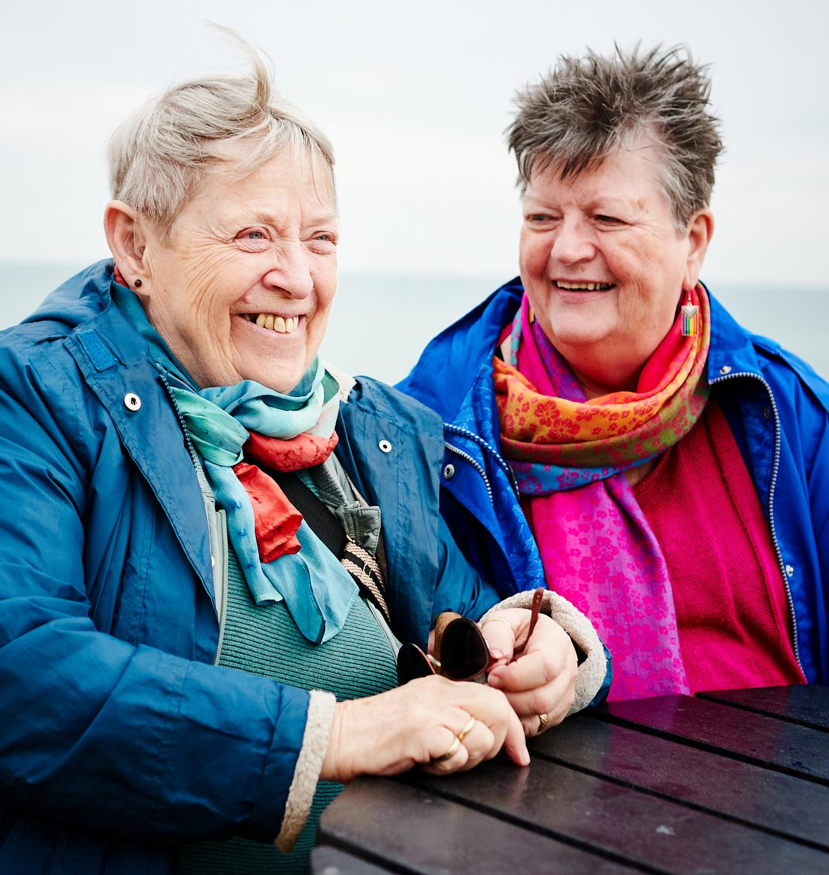
About our Foundation
Our Vision, Mission and Values
Our 2024 Programmes
Grant Guidance
Top Tips
Timeline
FAQs (success rates, how we assess etc)
Questions
Cover image courtesy of Time to Talk Befriending. Copyright Matthew J Thomas
Right: Image courtesy of Switchboard

Slide 3
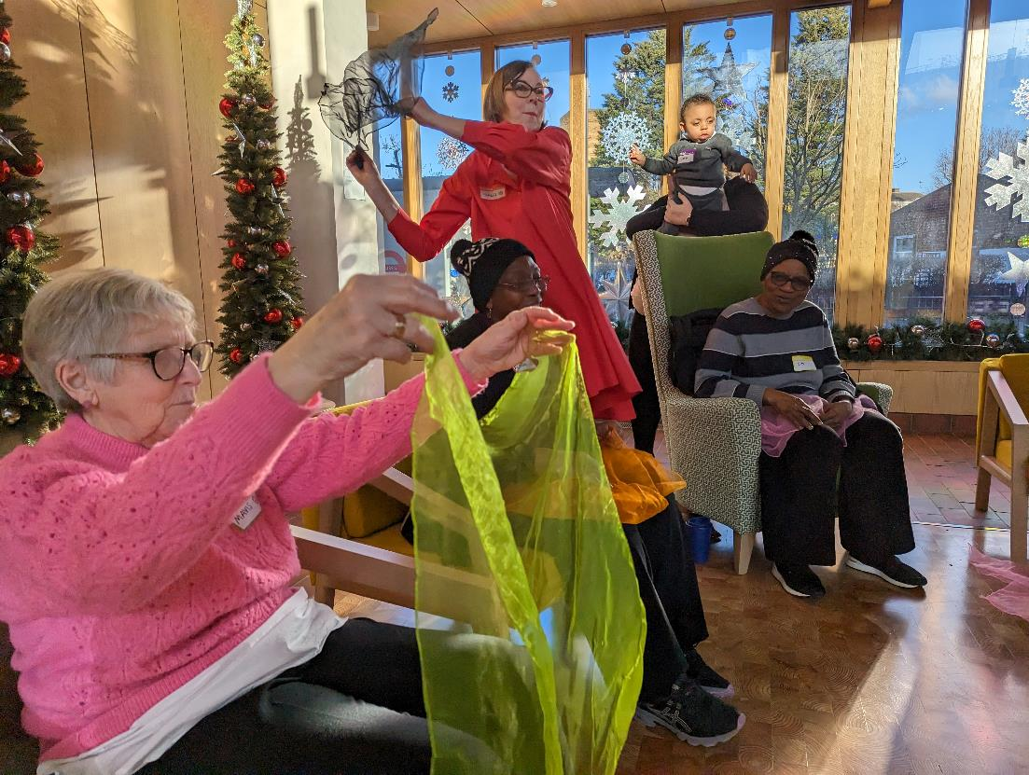
Our Vision, Mission and Values
Our vision is a society where older people are valued, connected and engaged with their communities.
Our mission is to help grassroots charities and community groups support older people by engaging the McCarthy Stone Group, People, Customers, and Partners.
Our values are:
We are positive about ageing
We are transparent and accountable
We are committed to improvement
Image courtesy of The Together Project at Appleby Almshouse in Southwark
“We're so delighted that McCarthy Stone Foundation has supported us for a second year. By funding our office, they have provided much-needed stability to our organisation and supported our ambitious growth plans for 2024, which will see us roll out our intergenerational Songs & Smiles programme across London.”
Louise Goulden, CEO, The Together Project
We are an independent registered Charitable Incorporated Organisation (CIO) in England and Wales reg no. 1191504, governed by a board of volunteer trustees, from McCarthy Stone and ‘independent’ members from outside the organisation. The Foundation delivers on its charitable purposes through grant making, project support and employer supported volunteering.

Slide 4
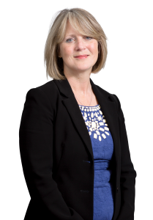
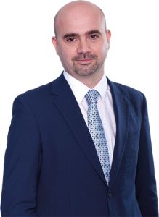
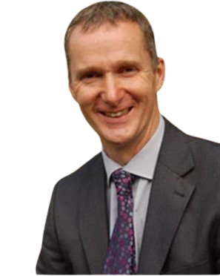
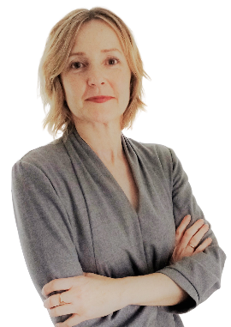
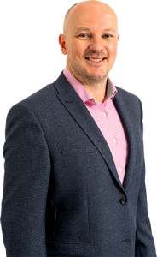
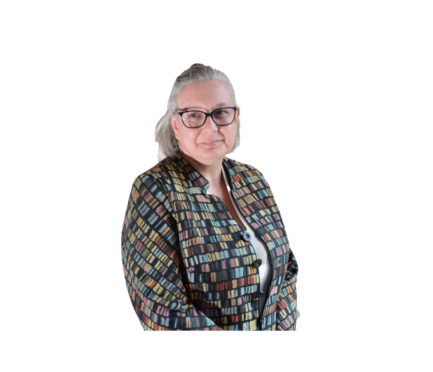
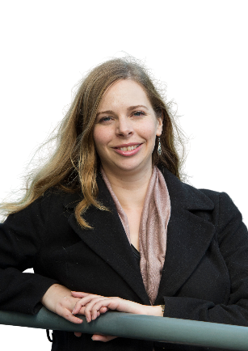
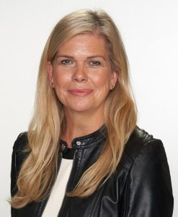
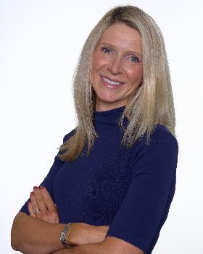
Our Team and TRustees
Graeme Marsh
Head of Foundation
Graeme.marsh@mccarthyandstone-foundation.org.uk
Paula Jordan
Chair
Paul Teverson
Trustee
Martin Edwards
Trustee
Liz Marsh
Trustee
Julia Laister
Foundation Coordinator
Julia.laister@mccarthyandstone-foundation.org.uk
Fiona Carleton
Trustee
Sarah Allport
Trustee
Dr Kim Smith
Trustee
www.mccarthystonefoundation.org

Slide 5
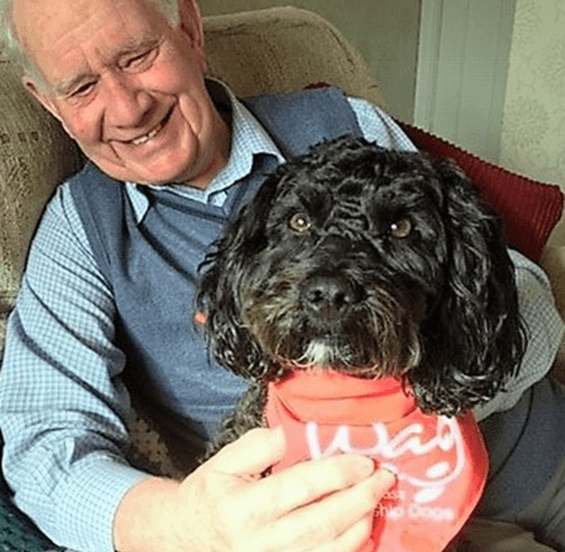
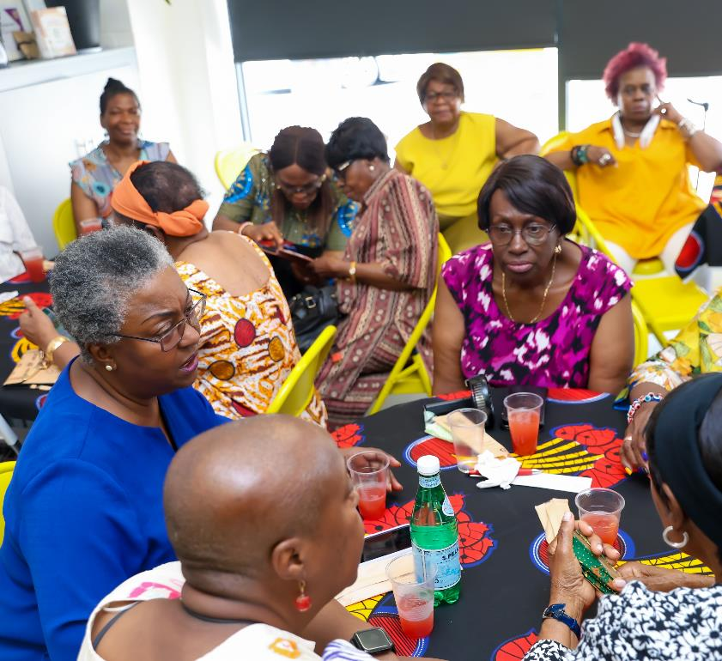
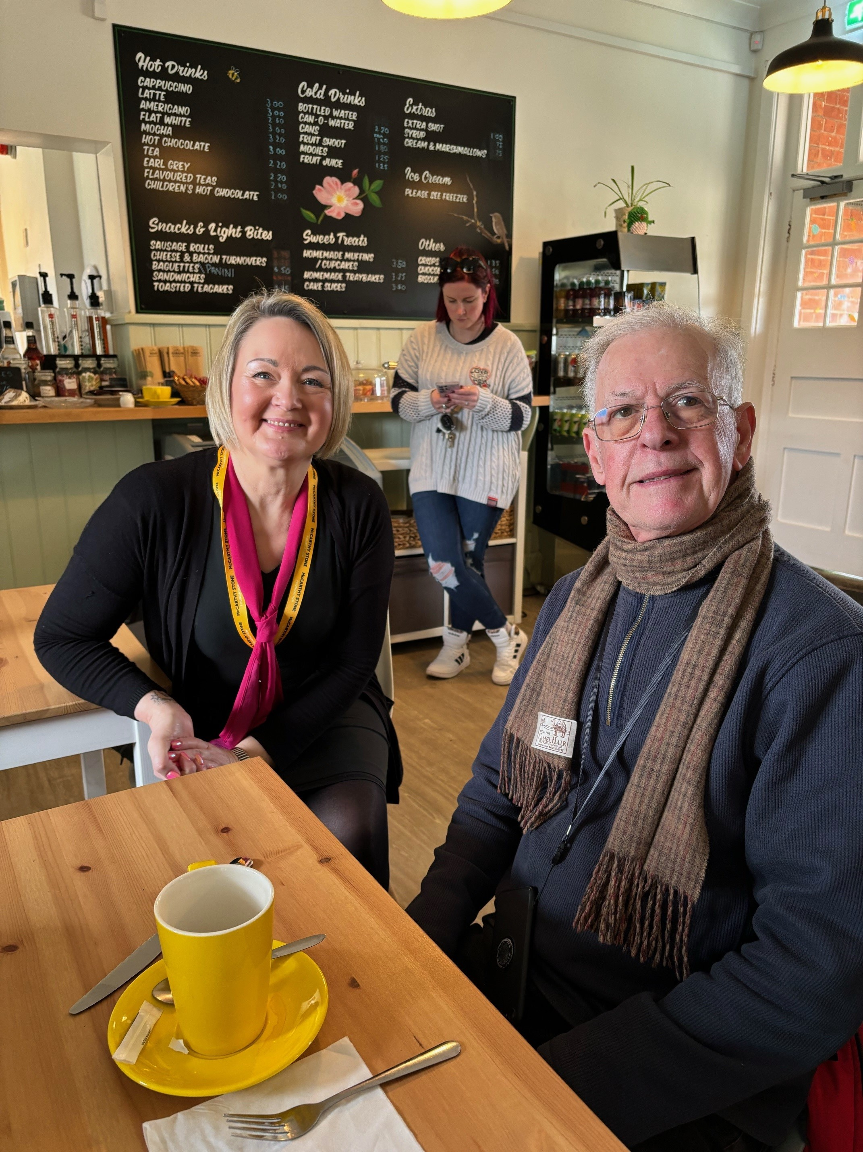
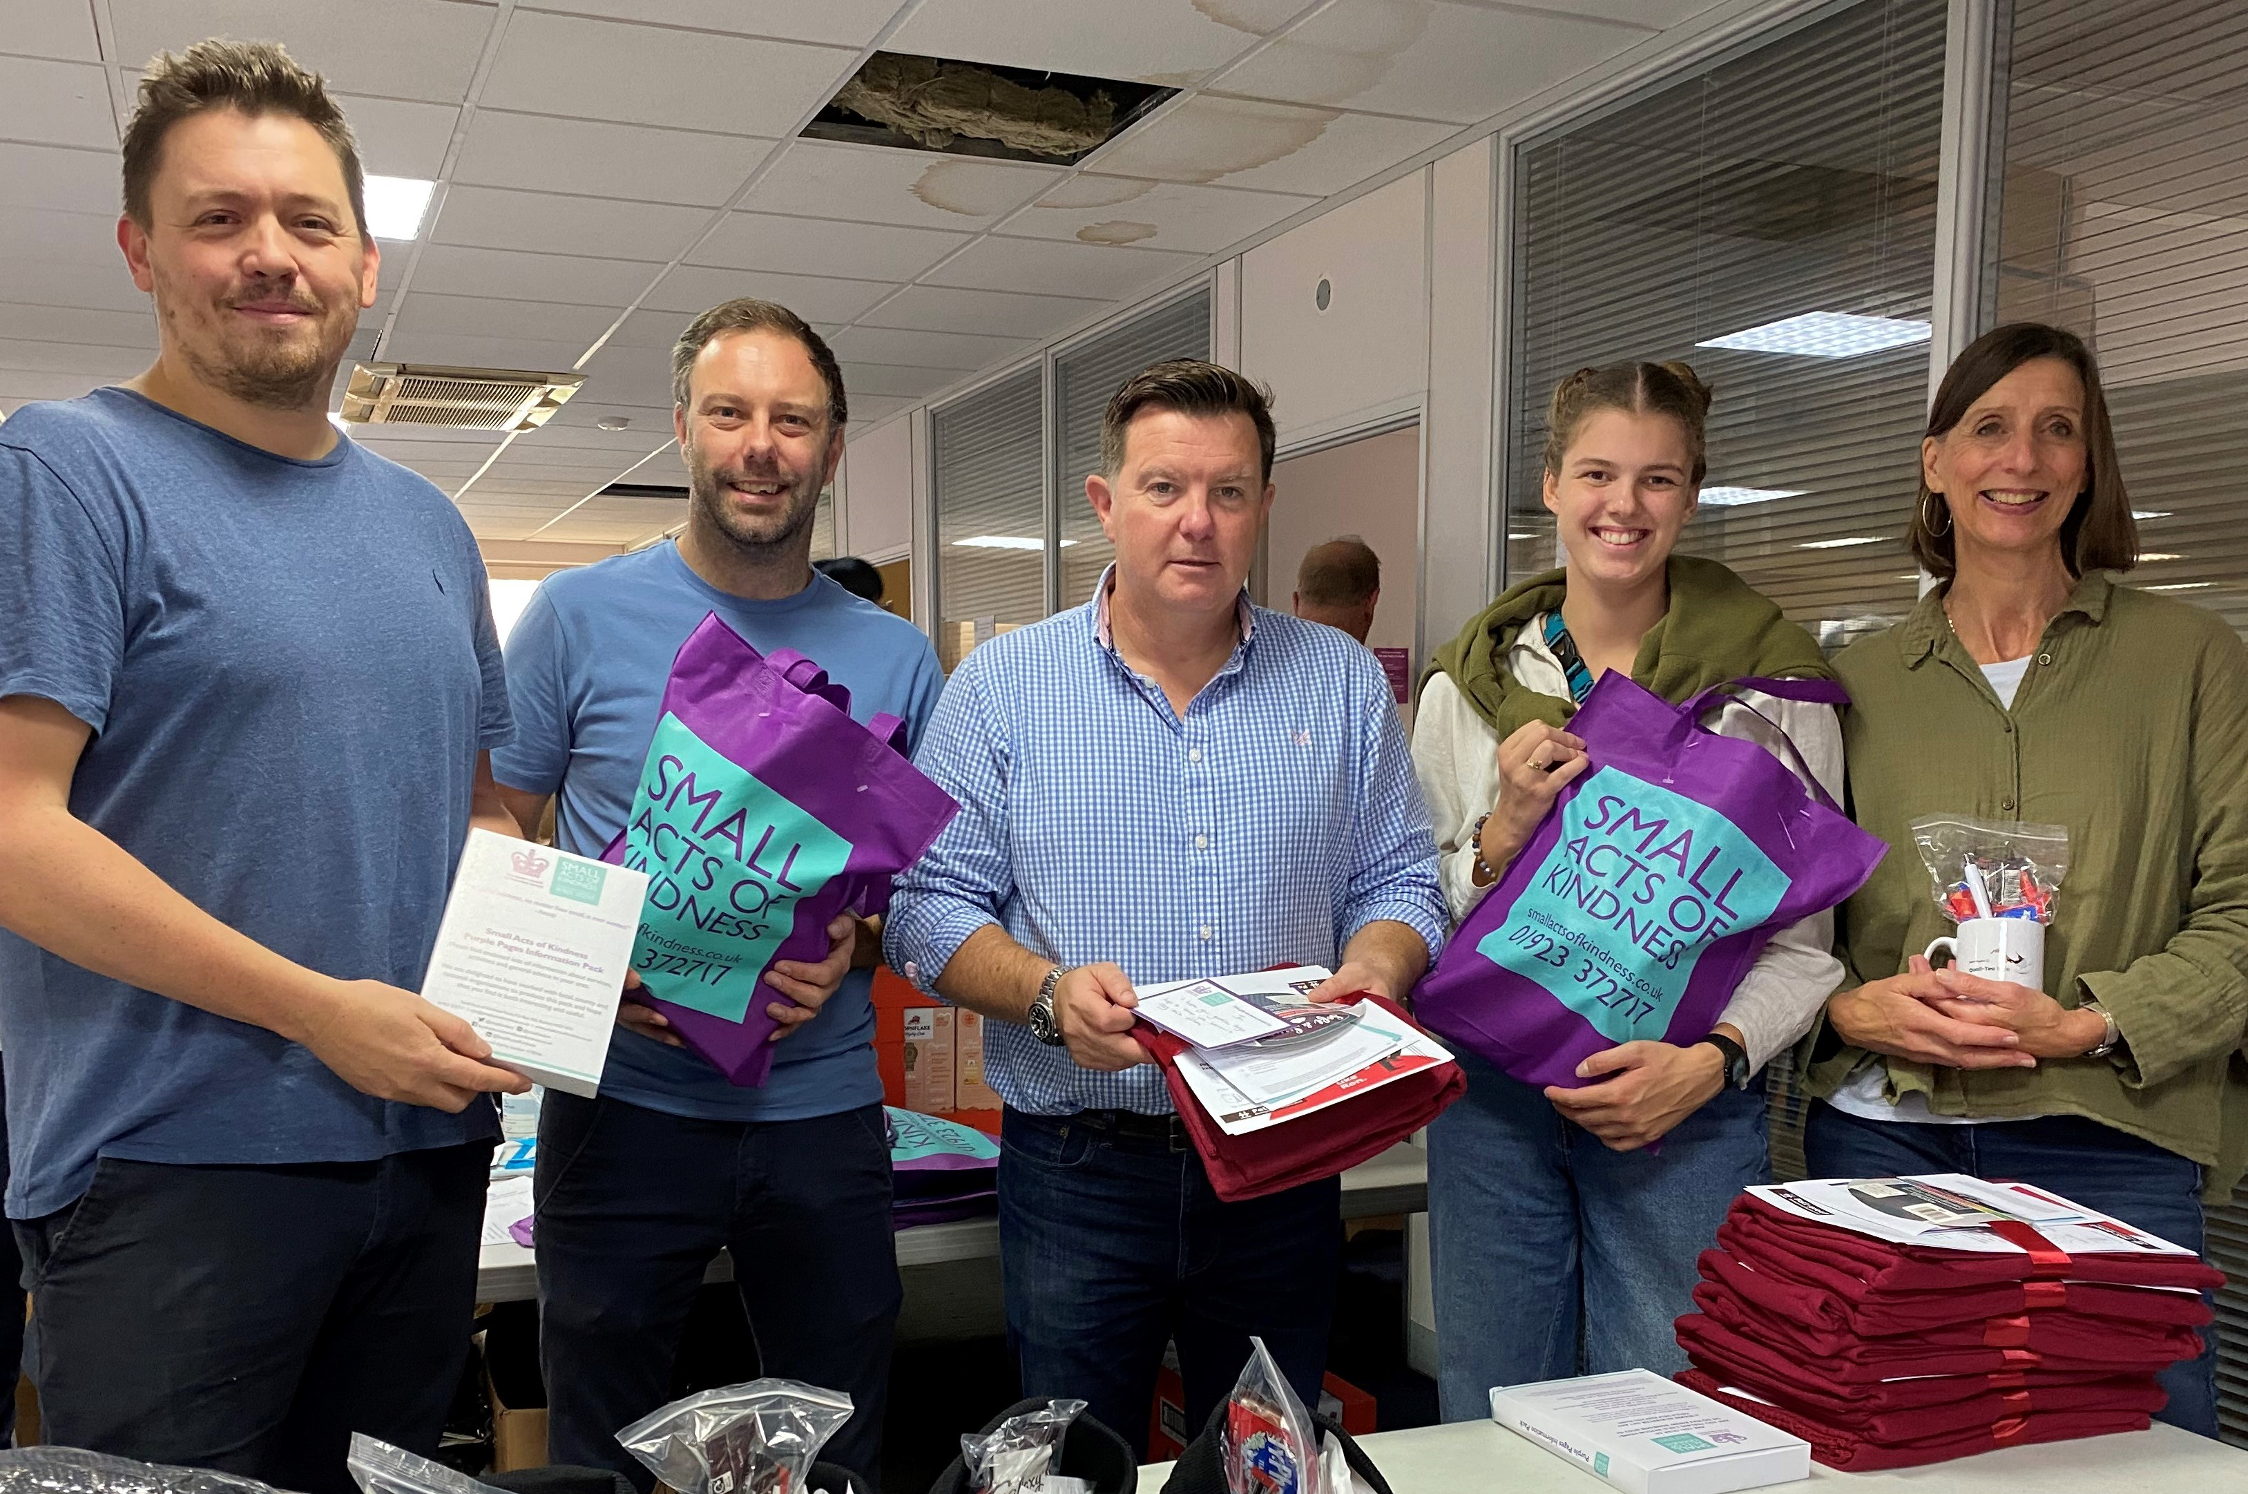
Our work so far
Since launching we have supported over 415 charitable causes across the country, awarding over £860,000 of funds.
Community Grants
Multi Year Partners
Welcome Wednesdays
Volunteering
Small grants of between £250 - £7,500 awarded to community causes working with people over 65 to alleviate loneliness and isolation.
£30,000 awarded over 3 years in unrestricted funding to help small charities build capacity.
Monthly social sessions held in Community Cafes and Hubs around the country to provide opportunities for social interaction for people over 65. Currently 8 in operation with plans to launch another 10 this year.
Every colleague has TWO days paid a year to give back to their community or support the Foundation, with over 1000 hours completed in 2023.

Slide 6
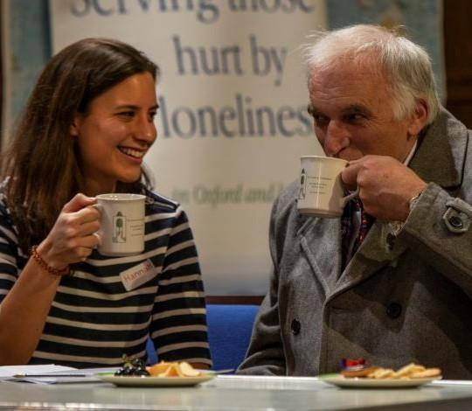
Our 2024 Grant Programmes
Our Autumn Grants programme will award c. £190,000 of funding across our 6 funding regions (Southern, London Southeast, Midlands, Wales, Northern, Scotland*).
Focusing on organisations providing direct 1-1 support e.g., befriending to people over 65 who are lonely or isolated.
Priority given to organisations working in more deprived areas or with groups that have higher levels of unmet needs.
Focused on providing opportunities for social participation for people over 65.
Priority given to more deprived areas and groups with higher levels of unmet needs.
Improving quality of relationships
Improving quantity of relationships
Notes:
Notes.
Caraway is a charity where MCS homeowners from The Boat House in Southampton volunteer. We previously gave them funding to start an additional three memory cafes in deprived areas of the city. This additional funding will pay for training and support to the partners/family of people living with dementia.
Goldies run Songs and Smiles all over Somerset and this funding is for a project to bring older people into local primary schools to talk and sing with the children.
Time To Talk work in some deprived parts of Brighton and Hove delivering an incredible befriending programme, with several specialist strands, including providing support at particularly challenging times and circumstances.

Slide 7
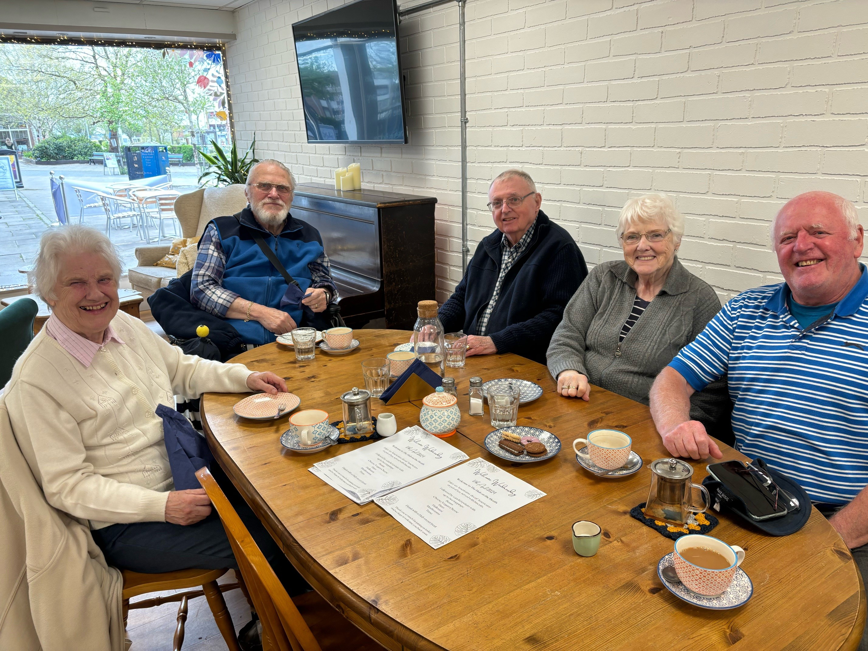
Welcome Wednesdays
In addition to our Grants Programme, we are looking for partners to join our Welcome Wednesdays Programme. This is NOT a grant programme, but a contracted service to deliver according to our (flexible) format.
A monthly social event with food and hot drink, held at a neutral community venue, typically a community café/hub. This should either be a non-profit or a non-profit subsidiary.
Funding provided for c.25 people per month @ £7.50 p.h.
Current venues in:
Southampton
Poole
Bournemouth
Leicester (upcoming)
Southend on Sea
Oxford (upcoming)
Nottingham
Tiptree (upcoming)
It is our plan to grow this to over 20 venues by the end of the year, adding a further 30 in 2025.
We are keen to find venues where the local area may be more deprived or provide limited services for older people but are open to any location as we look to raise the profile of the service.
If you would like to become a Welcome Wednesday partner, please apply by email to the Foundation team.
Notes:
Notes.
Caraway is a charity where MCS homeowners from The Boat House in Southampton volunteer. We previously gave them funding to start an additional three memory cafes in deprived areas of the city. This additional funding will pay for training and support to the partners/family of people living with dementia.
Goldies run Songs and Smiles all over Somerset and this funding is for a project to bring older people into local primary schools to talk and sing with the children.
Time To Talk work in some deprived parts of Brighton and Hove delivering an incredible befriending programme, with several specialist strands, including providing support at particularly challenging times and circumstances.

Slide 8
Grant Guidance
Please download the Grant Guidance and read it in full (it’s only two pages) before completing your application.
You must be a registered charity, community group with constitution or Community Interest Company working in England, Scotland or Wales with a turnover under £250,000 p.a. as evidenced in your recent annual report. We also consider exempt charities, but do not make grants to individuals or profit-making entities. If you are a CIC, you must be limited by guarantee and not applying for core costs.
You must be working with adults over 65 years of age and providing DIRECT person-centred interventions e.g., Befriending to address loneliness. This funding does not cover connector or infrastructure services, such as Citizens Advice or Community Transport, but can be used to support your own infrastructure costs.
Priority will be given to organisations working in an area of high deprivation affecting older people. We have listed out these areas in the appendix of the grant guidance, but please contact us before applying if you are unsure.
Funding is up to £7,500. There is no minimum amount. Wherever possible funding is unrestricted.
You will need to have a recent bank statement and a copy of your safeguarding policy available to send if shortlisted. If you are not a registered charity, we will need in addition, either your Articles of Association or a Constitution.
Notes:
Notes.
Caraway is a charity where MCS homeowners from The Boat House in Southampton volunteer. We previously gave them funding to start an additional three memory cafes in deprived areas of the city. This additional funding will pay for training and support to the partners/family of people living with dementia.
Goldies run Songs and Smiles all over Somerset and this funding is for a project to bring older people into local primary schools to talk and sing with the children.
Time To Talk work in some deprived parts of Brighton and Hove delivering an incredible befriending programme, with several specialist strands, including providing support at particularly challenging times and circumstances.

Slide 9
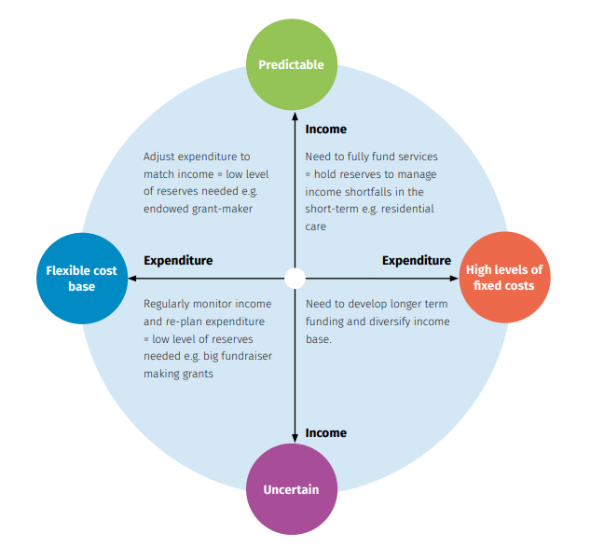
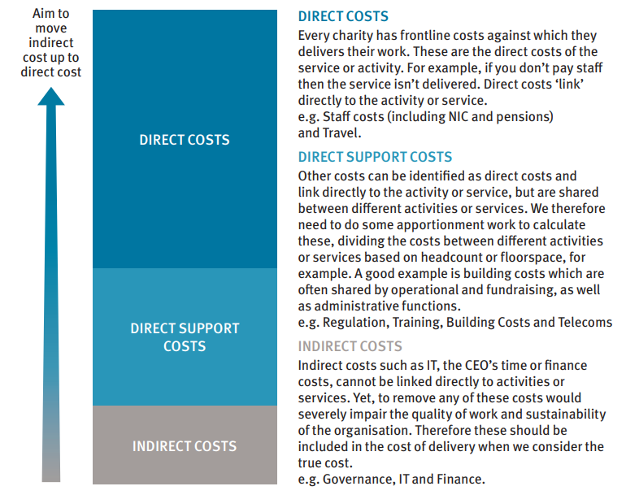
Reserves and Full Cost Recovery
12
SV-MS-ReservesPolicies-July2015.pdf (sayervincent.co.uk)
CCE-Cost-Recovery-Guide-Final-Version.pdf (city.ac.uk)
To calculate your reserves, begin with your ‘Unrestricted Funds’ balance, then remove any fixed assets (buildings etc), any Programme-related investments (PRIs) and any designations (take care not to use designated funds to reduce reserve figures). We would like to see your reserves policy as part of the application.
If applying for funds to support a particular project e.g., befriending, within your wider work, then you should ensure you are applying a full cost recovery approach to reflect the true cost of its delivery. Understanding this will help you plan and budget accordingly, as well as ensure funding doesn’t leave you with a shortfall.
Notes:
Notes.
Caraway is a charity where MCS homeowners from The Boat House in Southampton volunteer. We previously gave them funding to start an additional three memory cafes in deprived areas of the city. This additional funding will pay for training and support to the partners/family of people living with dementia.
Goldies run Songs and Smiles all over Somerset and this funding is for a project to bring older people into local primary schools to talk and sing with the children.
Time To Talk work in some deprived parts of Brighton and Hove delivering an incredible befriending programme, with several specialist strands, including providing support at particularly challenging times and circumstances.

Slide 10
Top Tips
Every funding round we see some great examples of applications, and some less so. Here are a few top tips to help your application stand out for all the right reasons!
Be clear about what you do, the first thing we look for is that your proposed/current work aligns with our aims.
Don’t cut and paste long sections from governing documents. Instead use a case for support or an edited section from another grant application. Everything we ask for should already be available to you.
Use bullet points to keep your information concise but do give us enough to understand what you do and why the funds are needed.
If applying for project funding, make sure your budget shows the true cost of the activity.
If applying for core funding, your primary activity should align with the aims of our grant programme (so if you also support a mother/baby group, we wouldn’t be able to give you core funding).
Don’t just write one or two lines per answer.
If you find written applications challenging to complete, we are open to receiving your application in other ways. However, we do still require the same information to make a decision.
Avoid jargon and abbreviations!
Notes:
Notes.
Caraway is a charity where MCS homeowners from The Boat House in Southampton volunteer. We previously gave them funding to start an additional three memory cafes in deprived areas of the city. This additional funding will pay for training and support to the partners/family of people living with dementia.
Goldies run Songs and Smiles all over Somerset and this funding is for a project to bring older people into local primary schools to talk and sing with the children.
Time To Talk work in some deprived parts of Brighton and Hove delivering an incredible befriending programme, with several specialist strands, including providing support at particularly challenging times and circumstances.

Slide 11
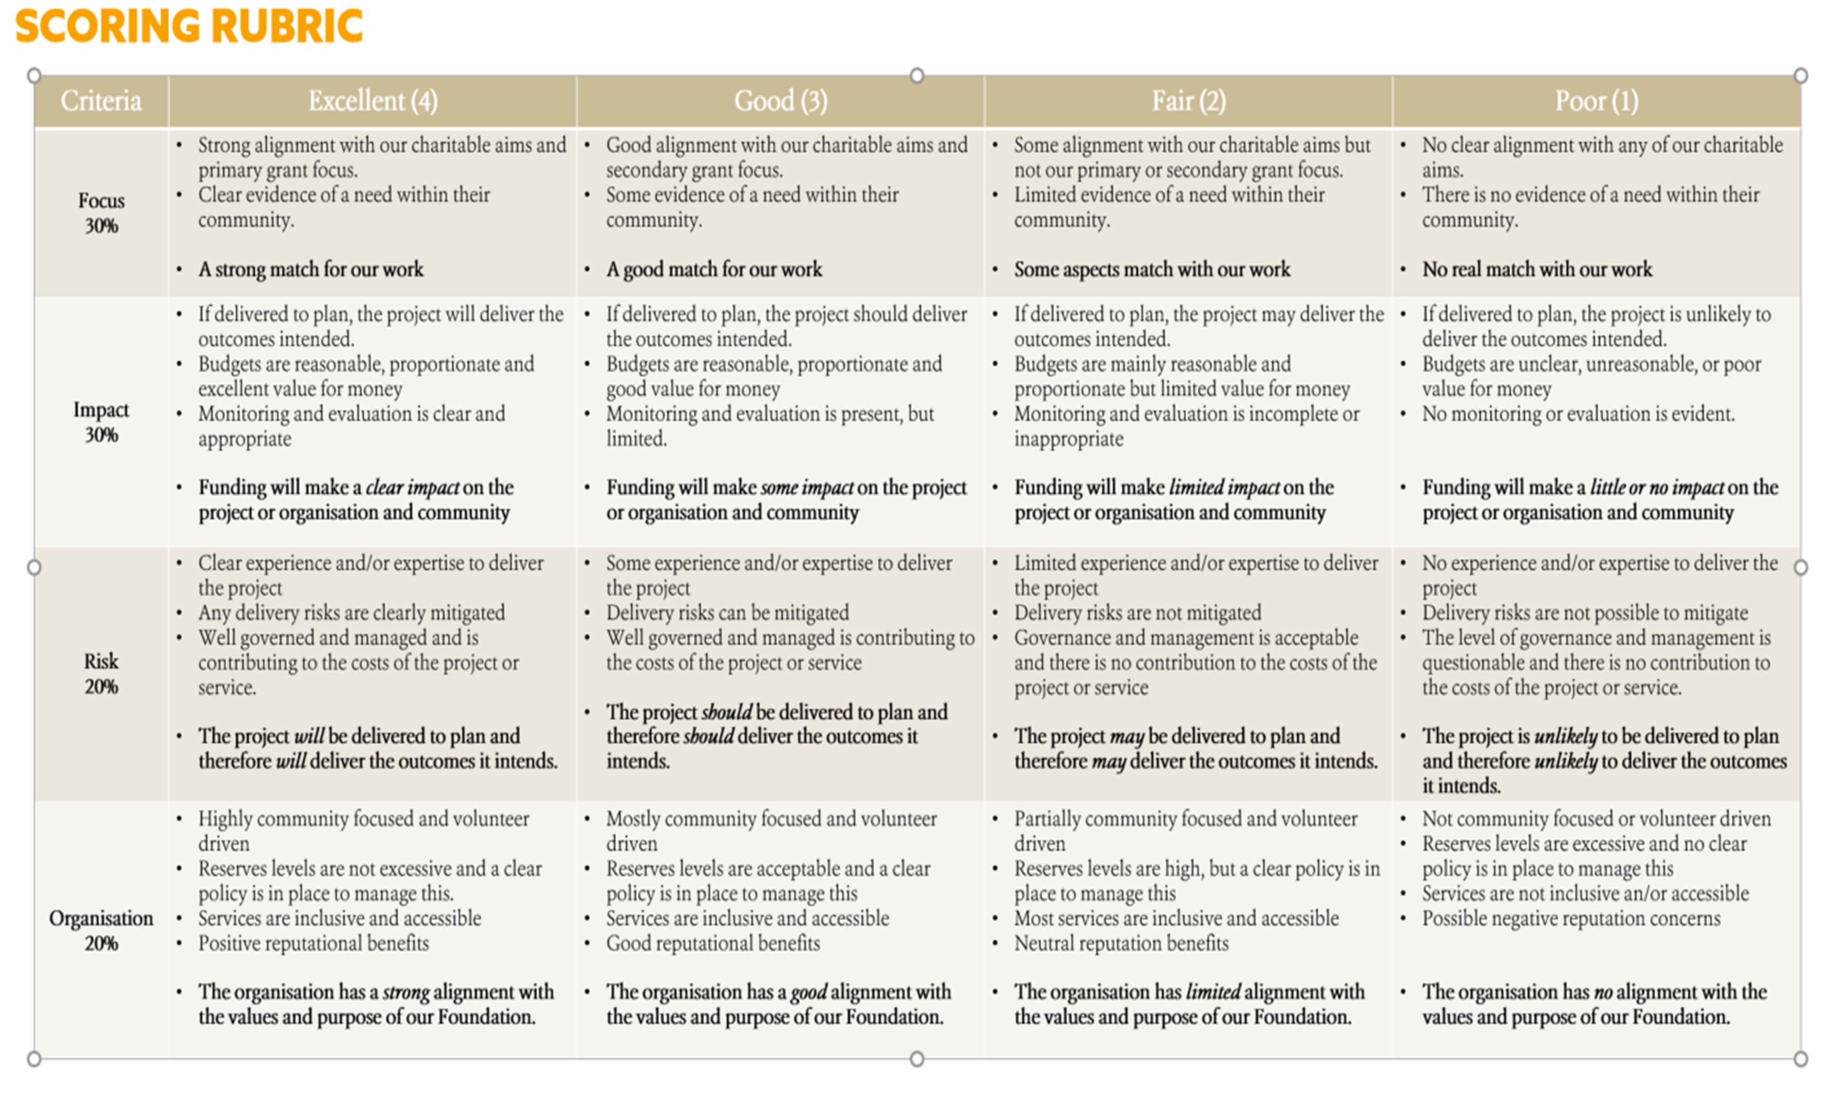
How we assess applications
Initial assessment is carried out by the Foundation team. At this stage we are looking at how your project aligns with our aims, your organisation profile, what you are proposing, and your budgets.
Before shortlisting, we also carry out due diligence, where we look a bit deeper at your organisation, including your accounts.
Around 15% of applications received are shortlisted for our Grants Sub-Committee, which consists of a representative from each region, two trustees, and the Foundation team.
Applications are assessed against four criteria: focus, impact, risk organisation. They are scored and then discussed at a Sub-committee meeting.
Regional representatives consider only applicants from their region, while Trustees and Foundation staff review all of them.
A recommended shortlist is created – typically around 25 are put forwards for an award.
The main trustee board reviews this list but does not see any other applications.
Notes:
Notes.
Caraway is a charity where MCS homeowners from The Boat House in Southampton volunteer. We previously gave them funding to start an additional three memory cafes in deprived areas of the city. This additional funding will pay for training and support to the partners/family of people living with dementia.
Goldies run Songs and Smiles all over Somerset and this funding is for a project to bring older people into local primary schools to talk and sing with the children.
Time To Talk work in some deprived parts of Brighton and Hove delivering an incredible befriending programme, with several specialist strands, including providing support at particularly challenging times and circumstances.

Slide 12
July 26th
Applications Open
August 23rd
Applications Close
September 16th
Initial Shortlisting completed by Foundation Team
October 30th Awards Disbursed
Sept 30th
Shortlist reviewed by Grant Committee and Awards Recommended
October 15th
Awards passed to Main Trustee Board for approval
Timeline
Notes:
Notes.
Caraway is a charity where MCS homeowners from The Boat House in Southampton volunteer. We previously gave them funding to start an additional three memory cafes in deprived areas of the city. This additional funding will pay for training and support to the partners/family of people living with dementia.
Goldies run Songs and Smiles all over Somerset and this funding is for a project to bring older people into local primary schools to talk and sing with the children.
Time To Talk work in some deprived parts of Brighton and Hove delivering an incredible befriending programme, with several specialist strands, including providing support at particularly challenging times and circumstances.

Slide 13
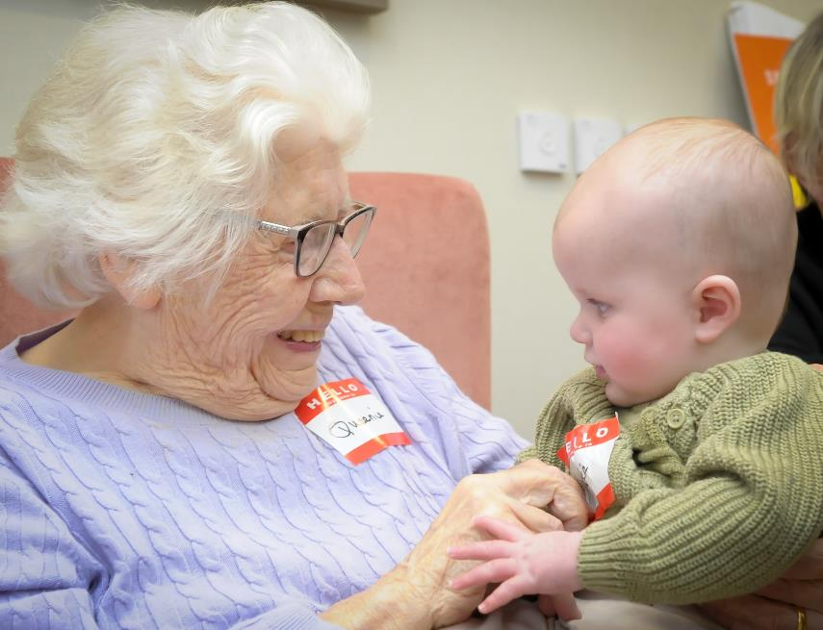
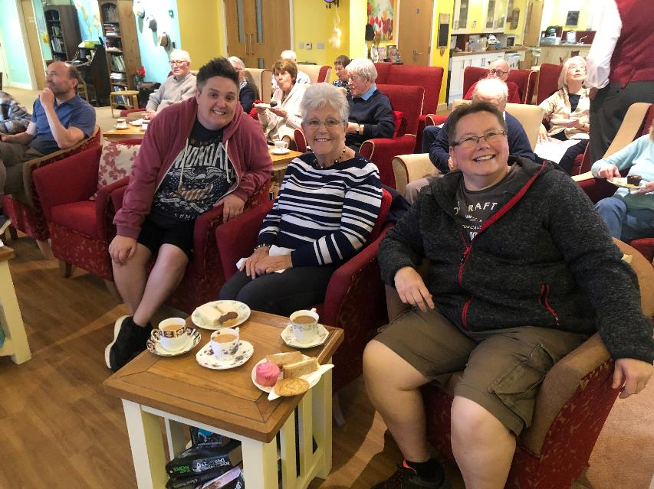
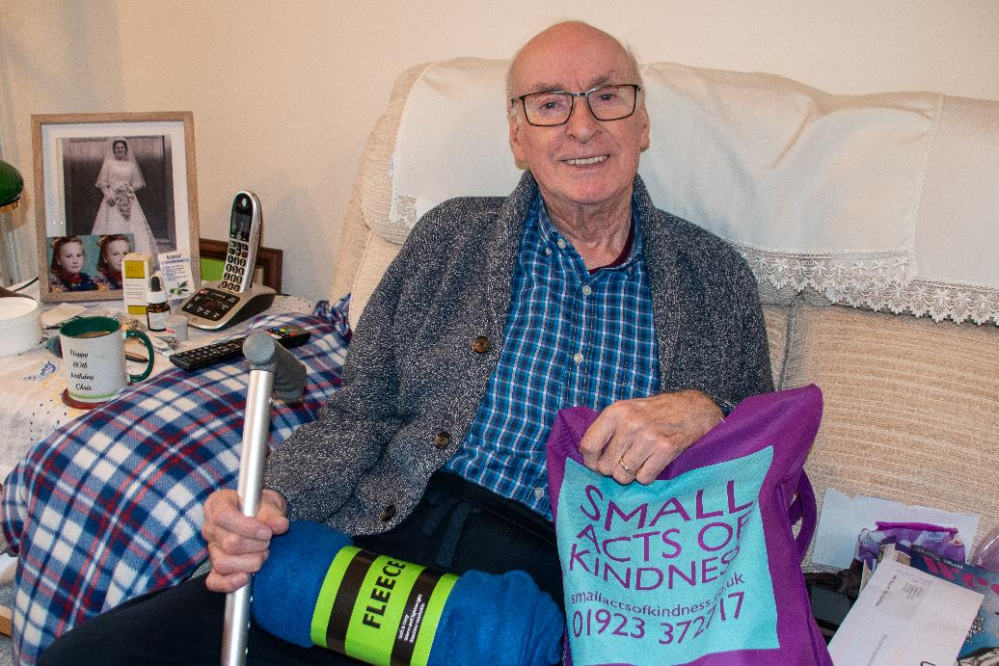
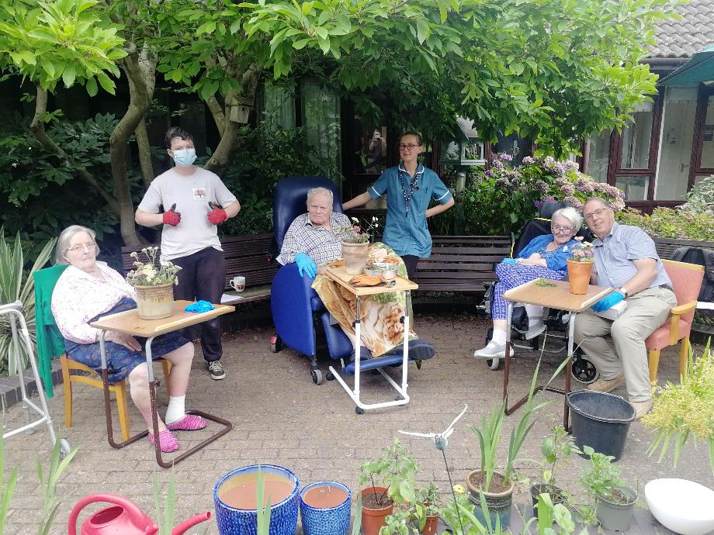
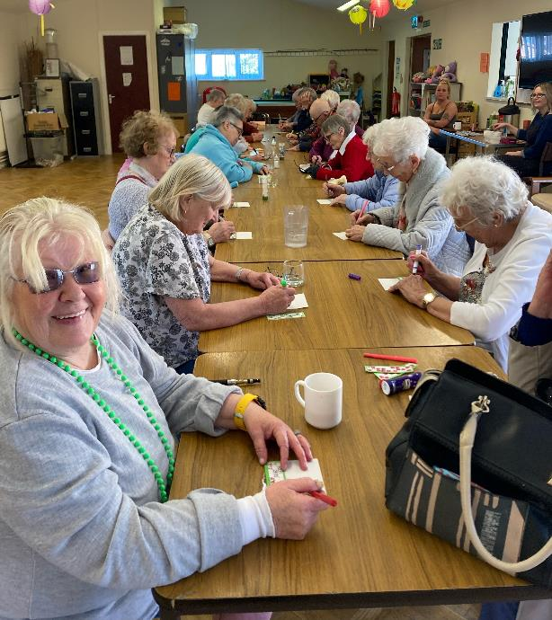
Questions

